Slide 1
The Customisable Weight Management Solution
TLS™ Weight Management Solution
tlsmasg

Slide 2
Disclaimer
You should consult your healthcare provider before beginning this or any other weight management programme. This programme has not been evaluated by the health agencies in Singapore. This presentation is not intended to diagnose, treat, cure or prevent any disease. Individuals following the TLS™ Weight Management Solution as part of a healthy diet and exercise programme can expect favourable result in their weight management.

Slide 3
TLS™ - 4 Fundamental Components
New Favourite Foods – Low Glycaemic Impact Eating
Improved Body Composition
Less Fat, More Muscle, Great Shape
Repair or Tune Up Your Metabolism
Selective Supplementation – Maximise Your Body’s Response
Practice Common Sense – Education...You just have to know the Basics
START LIVING WITH TLS TODAY
#FINDYOURFIT
#TLSWEIGHTMANAGEMENT

Slide 4
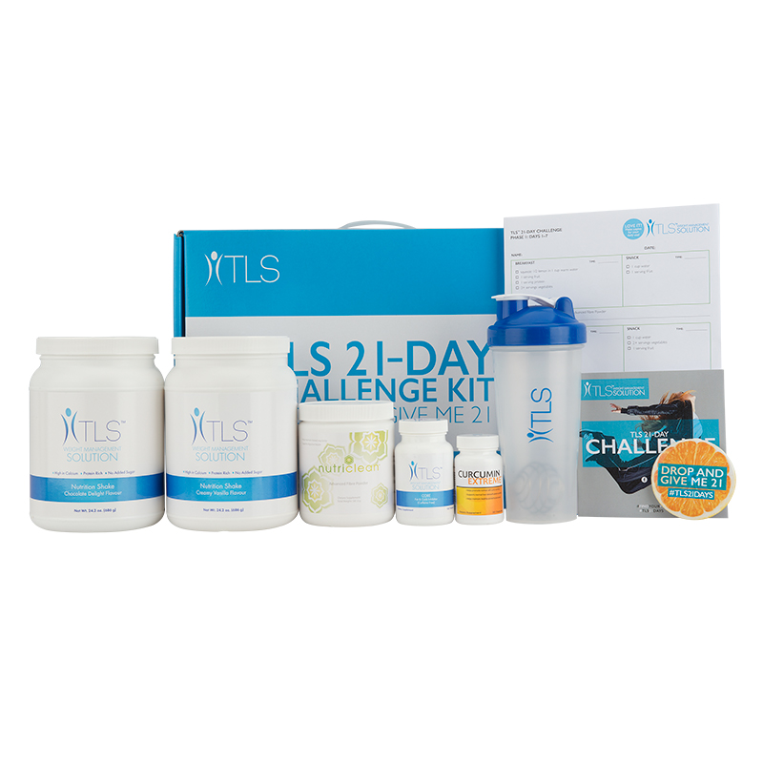
You Have TLS™ Weight Management Options
TLS 21-Day Challenge Kit – for a get started and see if it is
“right for me”
weight management solution.
Code: SG21DAY
UC: S$186.00 SR: S$260.50
BV: 25
START LIVING WITH TLS TODAY
#FINDYOURFIT
#TLSWEIGHTMANAGEMENT

Slide 5
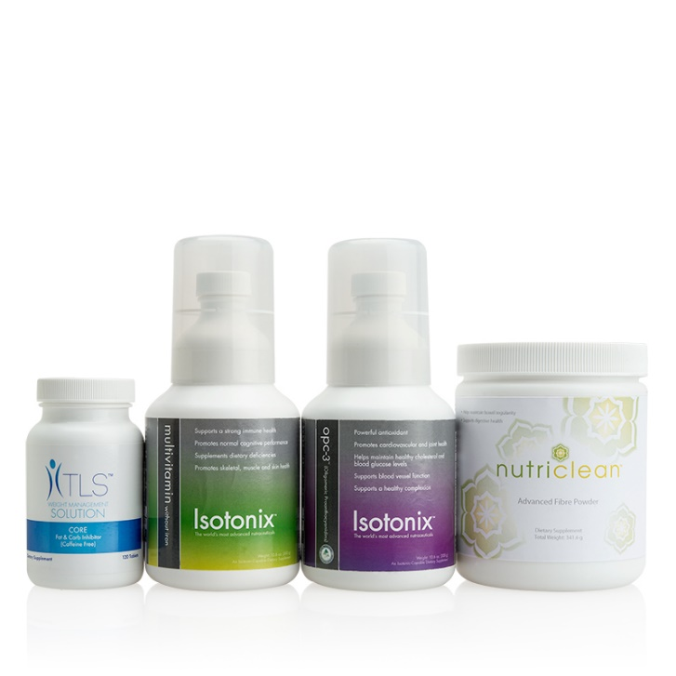
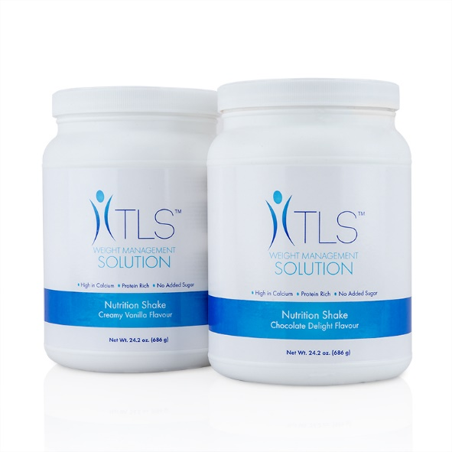
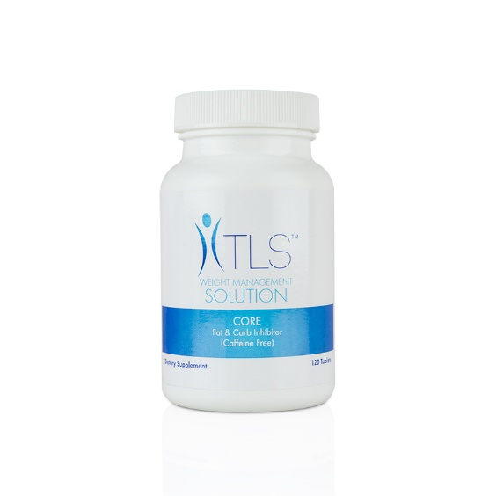
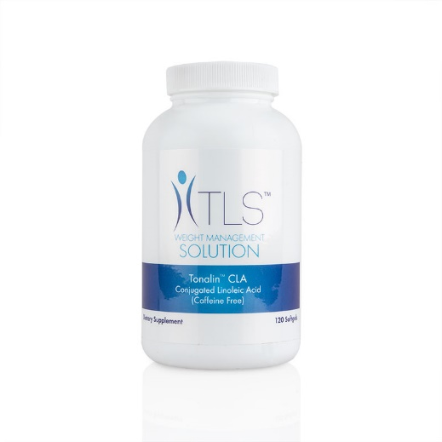
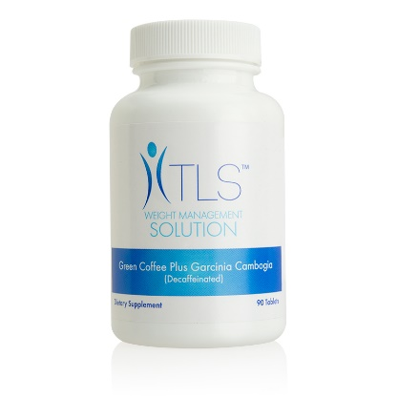
You Have TLS™ Weight Management Options
TLS 7 Day Detox with customised into 4, 6, 8 or 12 week programme
TLS Continued Commitment
Fat Burning /
Rapid Result /
Sure & Steady
DETOX KIT
Code: SG6464
UC: S$209.00 SR: S$292.50
BV: 106
TONALIN™ CLA
Code: SG6428
UC: S$51.50 SR: S$71.95
BV: 22
NUTRITION SHAKES
SG6390 - Vanilla
SG6391 - Chocolate
UC: S$39.50
SR: S$55.25 BV: 8
GREEN COFFEE PLUS GARCINIA CAMBOGIA
Code: SG6426
UC: S$41.25 SR: S$57.75
BV: 19
CORE
Code: SG6462
UC: S$63.50 SR: S$88.95
BV: 32

Slide 6
Is there a market? Ask a friend!
Are you concerned about a family history of weight-related health challenges?
Are you concerned about sleep quality or energy?
Are you concerned about rapid ageing?
Are you concerned about sexual desire?
Are you concerned about joint discomfort?
Are you interested in looking and feeling better?

Slide 7
AROUND THE GLOBE, TLS™ SCORES!

Slide 8
Does TLS™ Weight Management Solution Work?
TLS Global Sales Are UP
16.35%
through June
Over YTD 2015
SINGAPORE Sales Up 41.8%
YTD: Year To Date

Slide 9
SUCCESS
can be yours...
using the
TLS™ Weight Management Solution!

Slide 10
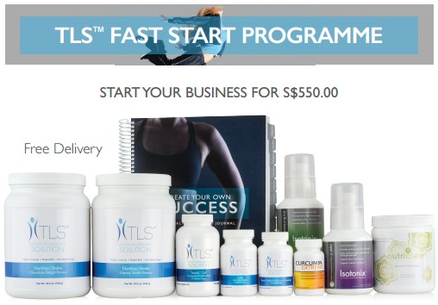
Newly Launched

Slide 11
Newly Added TLS In Home Overview
Available on unfranchise.com
Download> Support Materials > TLS (Category) > Training (Subcategory)

Slide 12
Everything begins with
being a Product of the Product!
Live the TLS™ Lifestyle!

Slide 13
Schedule Your TLS™ Activities
TLS In Home Overview
Start or conduct TLS 21-Day Challenge
Daily be an Internet Marketer
Participate in TLS Social Media - Use Hashtags - #FINDYOURFIT, #TLS21DAYS, #SGTLS, #SGFINDYOURFIT, #SGTLS21DAYS, #TLSWEIGHTMANAGEMENT
Remember to put your TLS Customers on the @TLSMASG Facebook page for added support.

Slide 14
Share Your TLS™ Story
People are happy to share their TLS Story and reach out for help...Social Media popularity is growing!
Facebook @TLSMASG
E-mail us!
product@marketsingapore.com.sg
START LIVING WITH TLS TODAY
#FINDYOURFIT
#TLSWEIGHTMANAGEMENT

Slide 15
The Customisable Weight Management Solution
TLS™ Weight Management Solution
tlsmasg

